Slide 1

Institute Of Technology Of Cambodia
Object Oriented Programming
Lectuer : 1. Mr. Tal Tongsreng (Course)
2. Mr. Chan Sophal (TP)
Member Group 06: BUT CHEABLENG
DORN DAWIN
LAY CHHAY
HUN SOKRARITH

Slide 2
Topic Cover :
The Assignment Operators.
Miscellaneous Operators.
Precedence Of Java Operators.

Slide 3
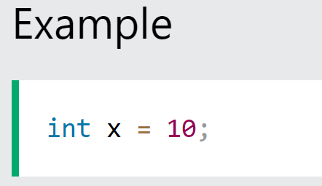
The Assignment Operators.
Assignment operators are used to assign values to variables.In the example below, we use the assignment operator (=) to assign the value 10 to a variable called x:

Slide 4
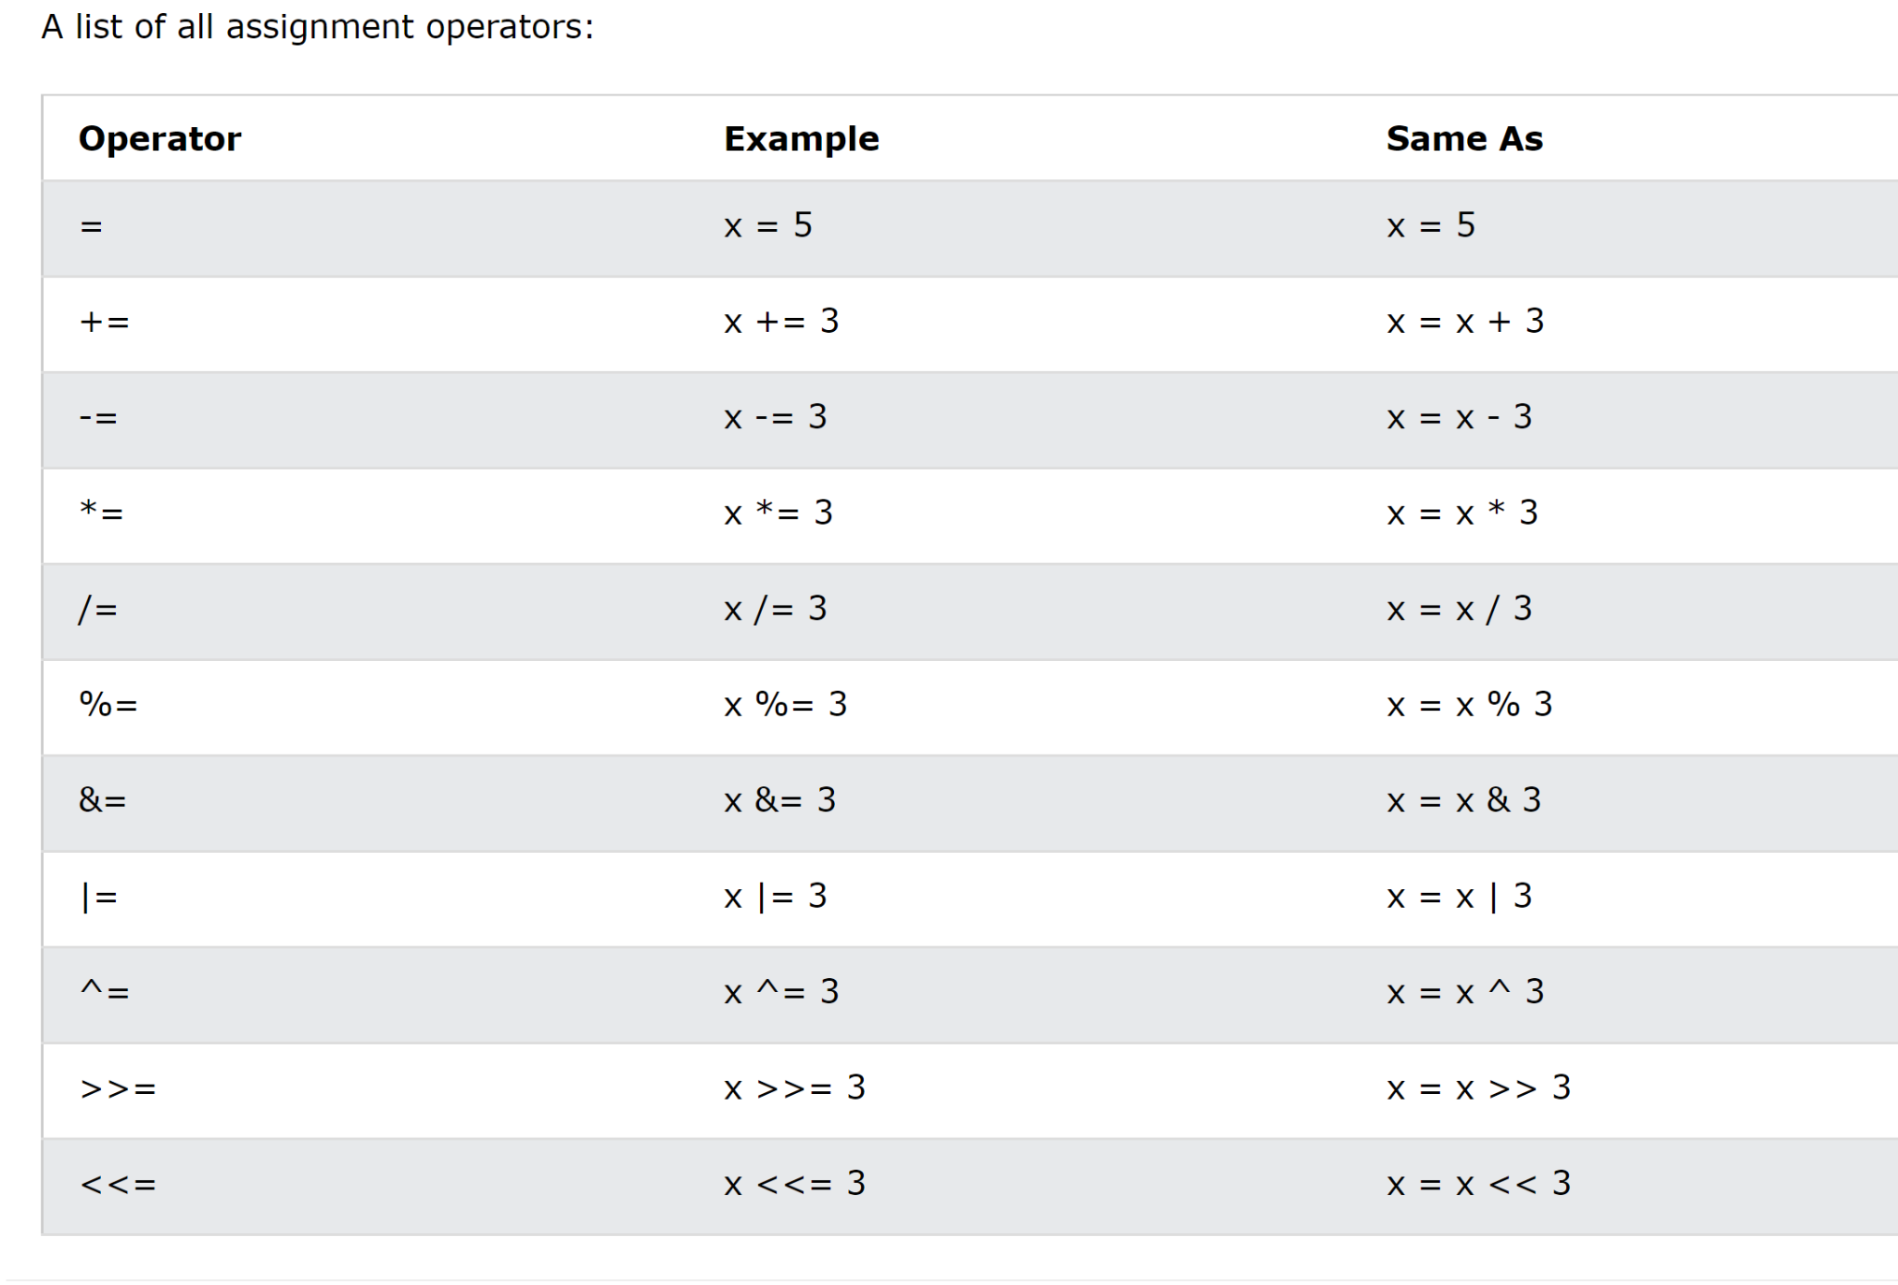

Slide 5
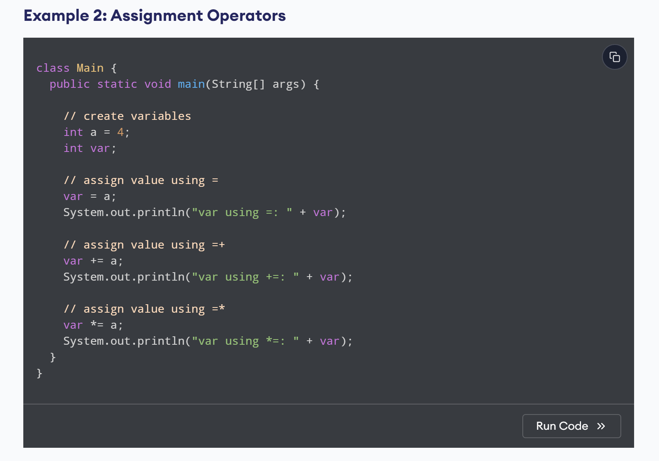
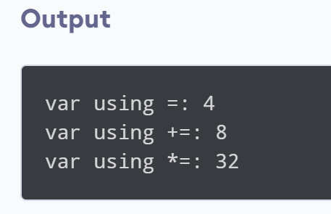

Slide 6
2. Miscellaneous Operators.
Java's miscellaneous operators are: ternary operator, member access, comma, array index, new, and instanceof.These operators are explained one by one in following sections.

Slide 7
2.1 Ternary or Conditional Operator ( ? : )
Conditional operator is also known as the ternary operator. This operator consists of three operands and is used to evaluate Boolean expressions. The goal of the operator is to decide, which value should be assigned to the variable. The operator is written as −
variable x = (expression) ? value if true : value if false

Slide 8
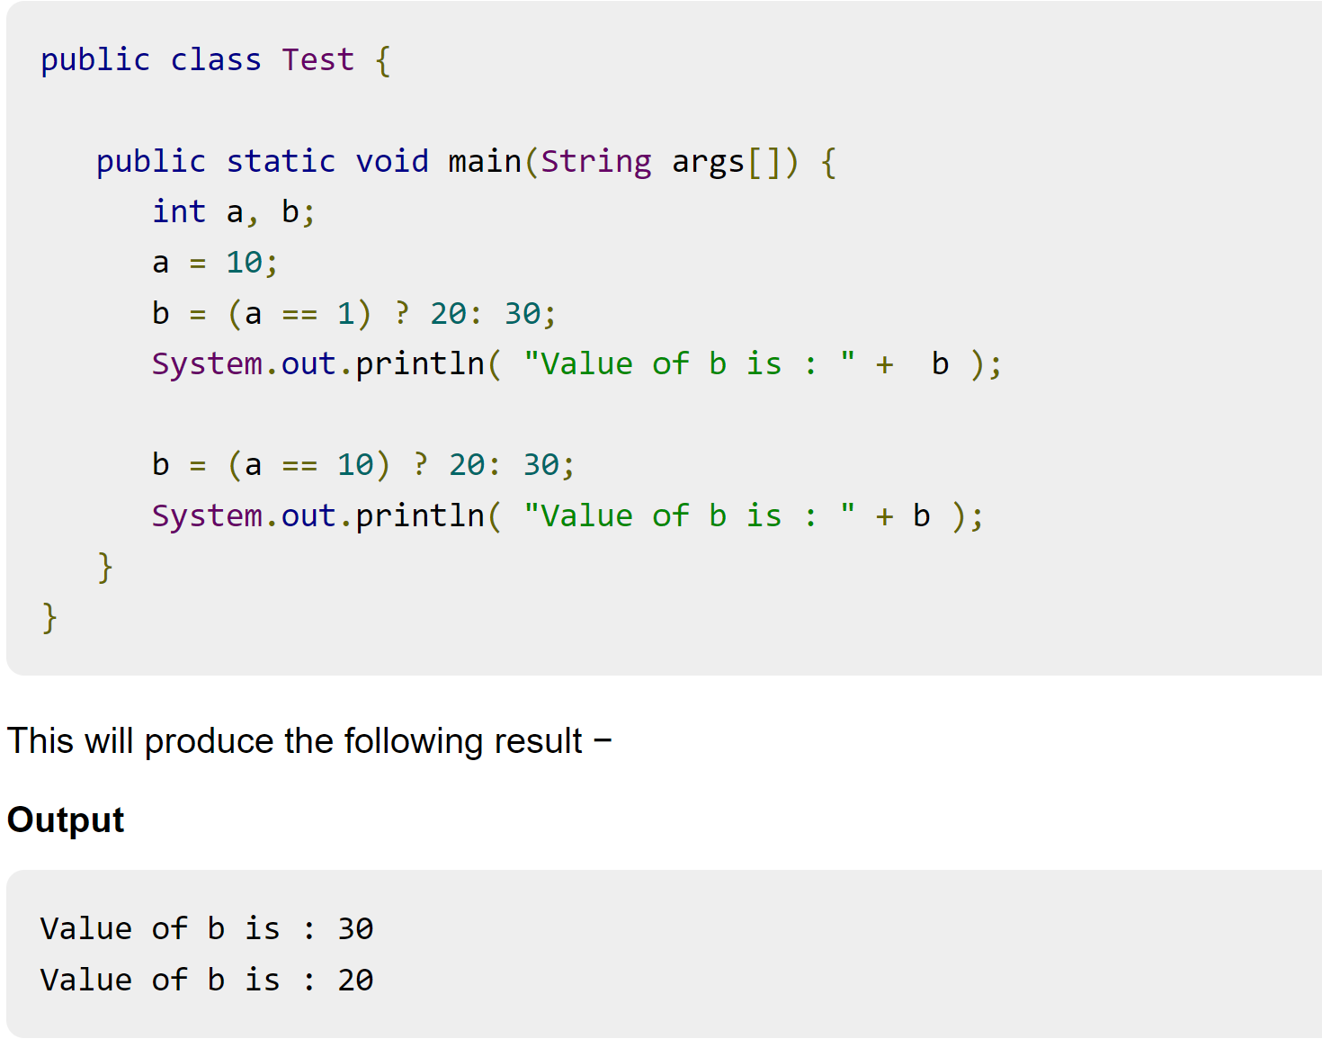

Slide 9
2.2 Member Access Operator
The Java member access operator is a dot (.) symbol that is used to access data members and member methods of a class by its objects.

Slide 10
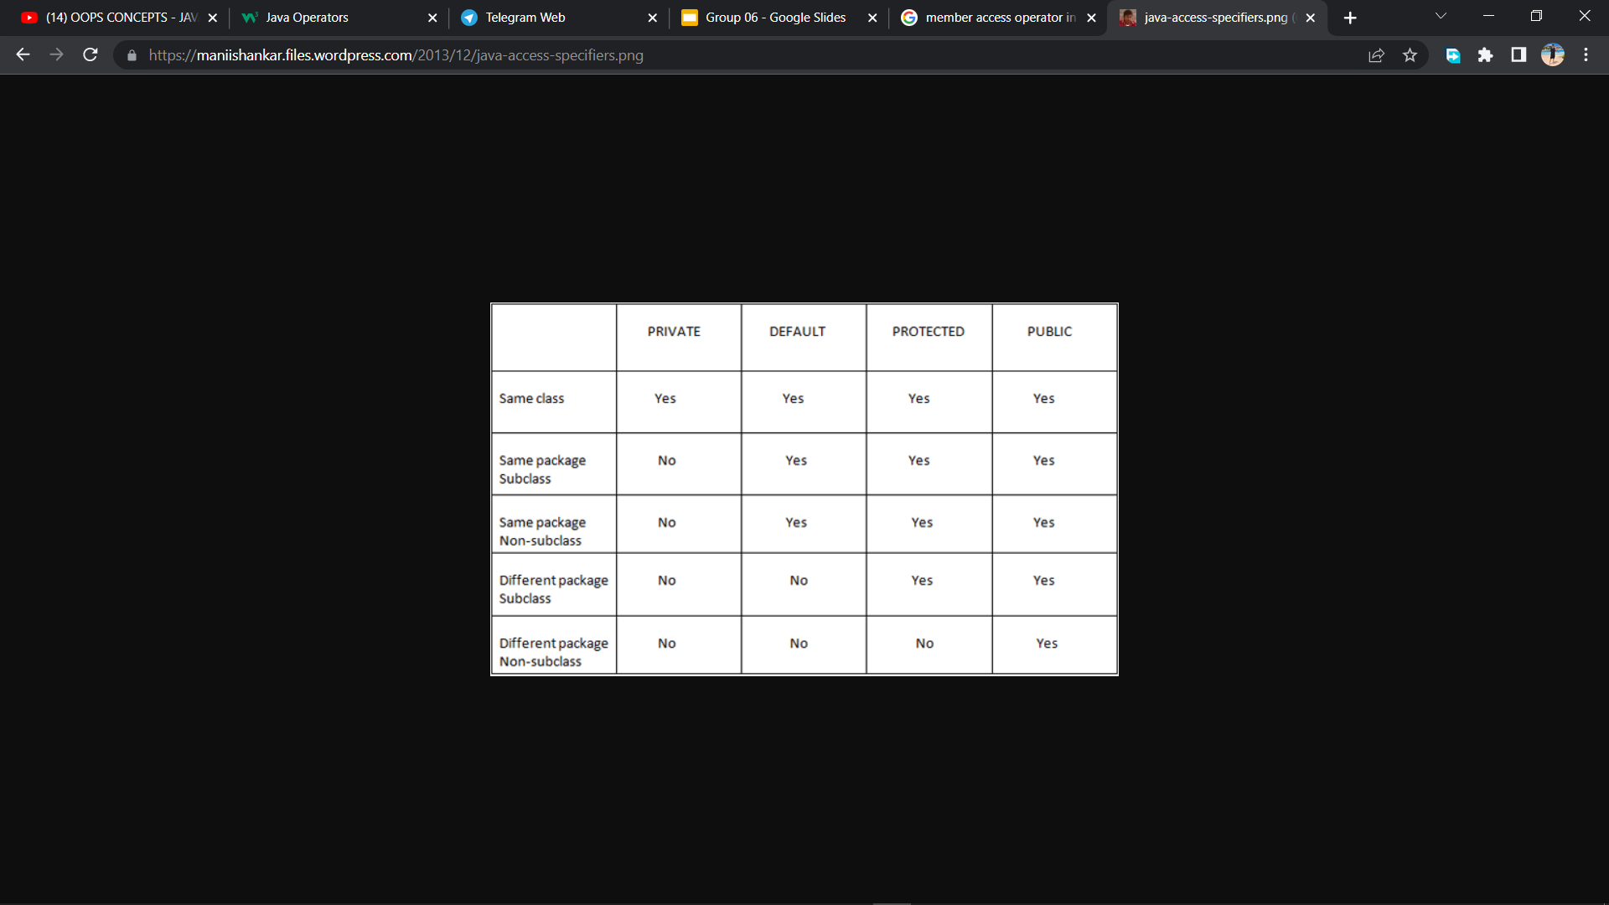

Slide 11
3. Precedence Of Java Operators.
Operator precedence determines the grouping of terms in an expression. This affects how an expression is evaluated. Certain operators have higher precedence than others; for example, the multiplication operator has higher precedence than the addition operator −
For example, x = 7 + 3 * 2; here x is assigned 13, not 20 because operator * has higher precedence than +, so it first gets multiplied with 3 * 2 and then adds into 7.

Slide 12
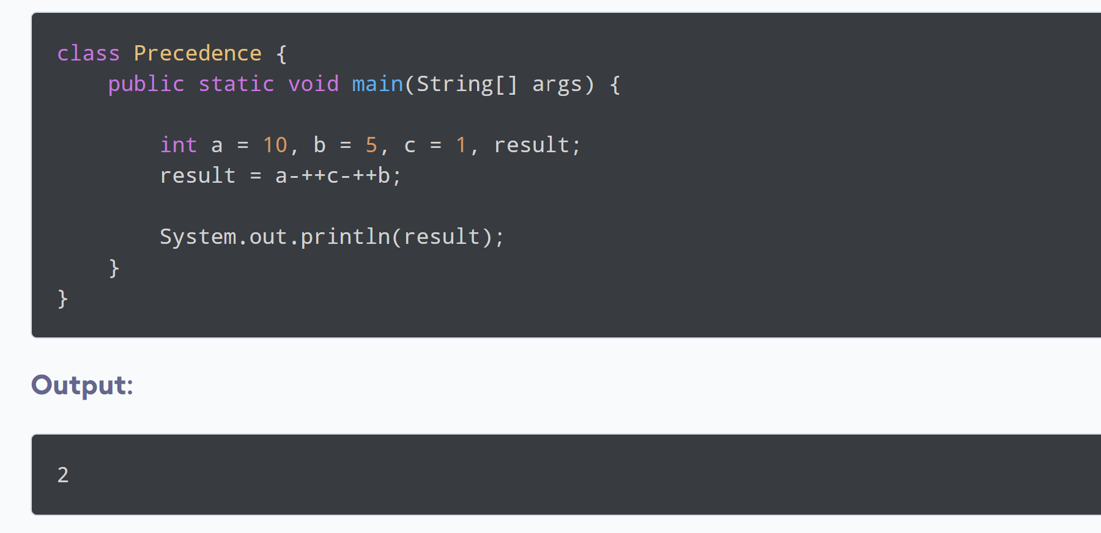

Slide 13
